Slide 1



Smart Pill Reminder and Tracker
A comprehensive solution for medication adherence
By : Jolian Abdo & Mohamad Abo Ahmad
Supervisor : Dr. Uzi Rosen
25-2-D-21

Slide 2
Presentation Outline
Introduction
Problem Statement
Challenges & Objectives
Requirements
Innovation and Contribution
Existing Systems & Gaps
7. Technological Review & Mobile interface
8. Mechanical Engineering
9. System Architecture
10. Use Case & Sequence & Activity Diagram
11. Challenges
12. Measuring Project Success (Evaluation Metrics)
Let’s get started!
1

Slide 3


Introduction
~ 150 million Europeans individuals struggle with medication adherence, particularly:
Elderly patients managing multiple prescriptions
People with complex medication regimens
Individuals with memory impairments
These challenges lead to reduced treatment effectiveness, increased health risks, and unnecessary stress for patients and caregivers.
[According to the World Health Organization (2003)
supported by more recent studies]
2
Notes:
Over 150 million people in Europe struggle with medication adherence. This includes elderly people or patients with memory issues, or anyone on a complex medication schedule. Forgetting a dose or taking the wrong one can lead to serious health consequences.

Slide 4


3
Problem Statement & Motivation
Medication errors, missed doses, and unanswered questions about interactions lead to poorer outcomes, more hospital visits, and caregiver stress.
1
Adherence Uncertainty
Users forget if they’ve taken a dose—or accidentally double-dose—and alarms alone can’t confirm a pill was removed.
2
Static, Generic Guidance
Built-in FAQs or one-off interaction tables don’t answer “Why did I get this side effect?” or tailor warnings to age, comorbidities and local regulations.
3
No Real-Time Verification
Basic pillboxes log openings but can’t verify true removal—and offer no conversational follow-up if something seems amiss.
4

Slide 5





Project Objectives
4
Develop Smart Pill-Box Prototype
Integrate weight sensors, lid-open detectors and environmental monitors to detect and verify actual pill removals in real time.
Integrate Real-Time Drug-Interaction Checker
Seamlessly cross-reference any two medications (plus patient age/comorbidities) to issue personalized contraindication alerts
or suggest safe alternatives.
Implement GPT-Powered Conversational Assistant
Deliver clinical-grade, context-aware Q\&A (free-text & multi-lingual), fully tied to each user’s prescribed regimen.
Build Mobile App & Caregiver Portal
Transform raw sensor events and AI chat logs into clear adherence reports,
weekly health snapshots and timely alerts for patients, caregivers and clinicians.

Slide 6
5
Requirements for Our project
 | Functional Requirements
1 | The system should allow users to arrange pills schedule via mobile application
2 | AI for missed dose prediction and drug interaction detection
3 | Synchronizes data between the pill box, mobile app, and cloud
4 | Sends reminders and alerts to users and caregivers
 | Non-Functional Requirements
1 | The System should include Smart pill dispenser with embedded sensors
2 | The system should support Real-time synchronization with minimal latency
3 | The system should support multiple users
4 | User friendly Scalable for home use
.
.
.
.
.
.
Notes:
"To meet those goals, our system had to be reliable, secure, and easy to use. The hardware needed precise sensors, and the software had to sync in real time, support multilingual AI responses, and ensure user privacy."

Slide 7
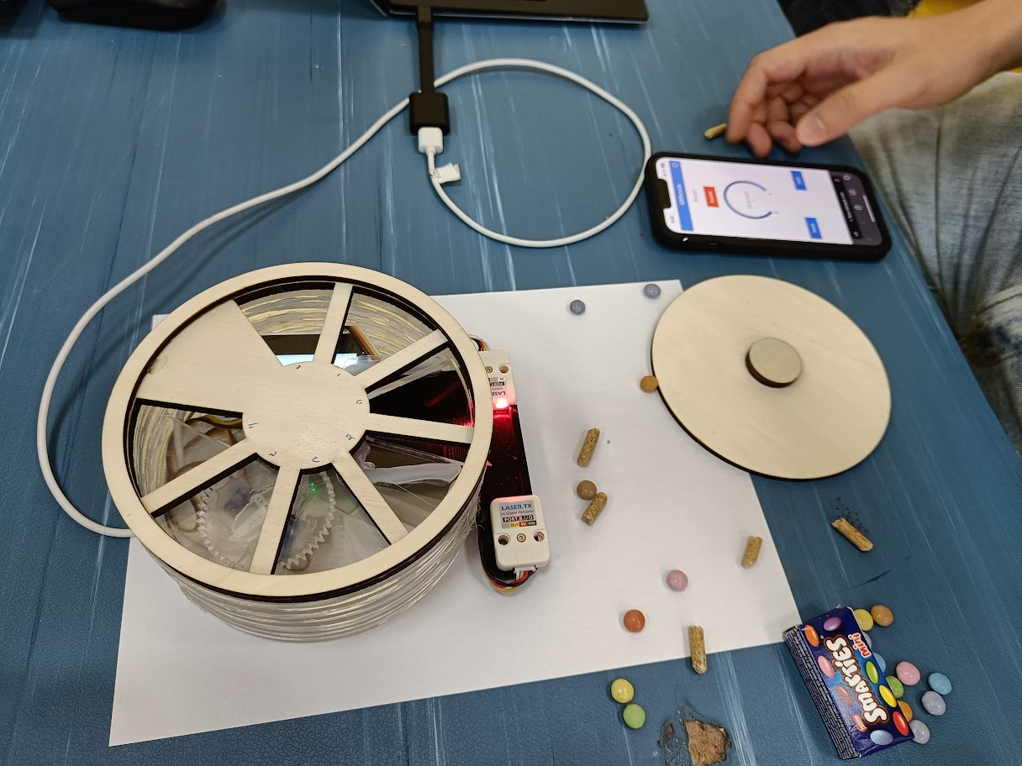

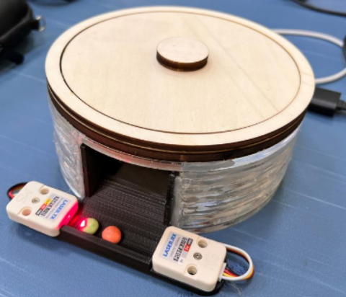


6
Innovation and Contribution
💊
Integrated Management
Smart Pill-Box Integration Real-time weight sensors, lid-open detectors and environmental monitors feed AI–driven verification of every pill removal and storage condition.
🤖
Conversational AI Engagement-powered,
Clinical-grade dialogue for free-text Q&A, side-effect explanations and regimen guidance—available in multiple languages and directly tied to the user’s profile.
Dynamic Drug-Interaction Management
On-the-fly interaction checks triggered the moment a pill is removed, with personalized severity ratings and safe-alternative suggestions based on age, comorbidities and local guidelines.
Mobile & Caregiver Connectivity
Live streaming of sensor events and chat logs into the patient app and caregiver portal—driving push alerts, adherence dashboards and weekly health snapshots that everyone can act on.
Notes:
Pill Mate goes beyond basic pill boxes. It verifies actual pill intake using weight and lid sensors. It includes a smart AI assistant that talks to users in natural language. It checks drug interactions live. And it connects everything to caregivers, showing weekly health summaries and alerts, all in real time."

Slide 8
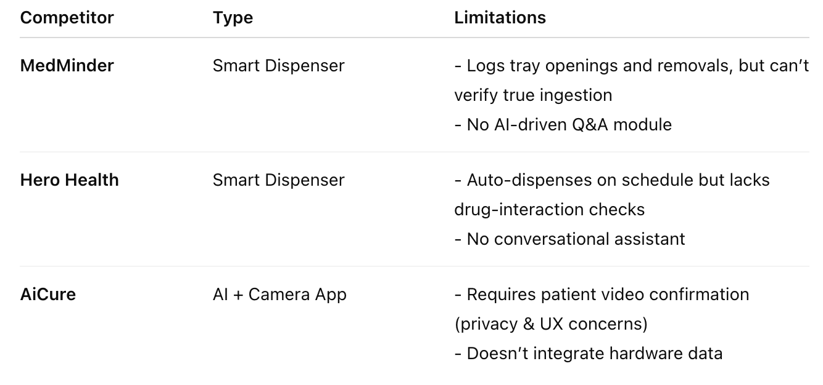
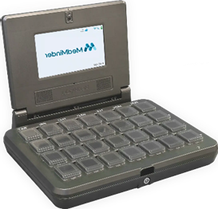

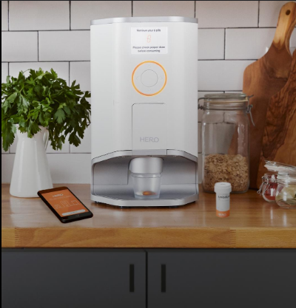
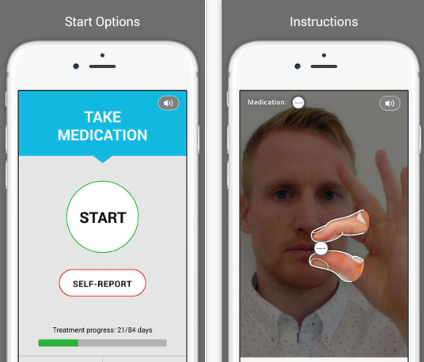
7
Existing Systems & Gaps

Slide 9

8
Project TimeLine
Kickoff & Project Selection
1
First meeting with Uzi: we picked our pill-box concept, defined target users and success criteria
Goals & Requirements
2
Set core objectives and drafted functional requirements for hardware + app.
Market Research
3
Reviewed existing smart/mechanical pill boxes, benchmarked features and best practices from literature.
4
UML & System Design
Created use-case, sequence and component diagrams and researched optimizations for cost, reliability and UX.
Project Review
5
Met with Uzi to validate UML models, POC prototype and user feedback; set final integration milestones.

Slide 10
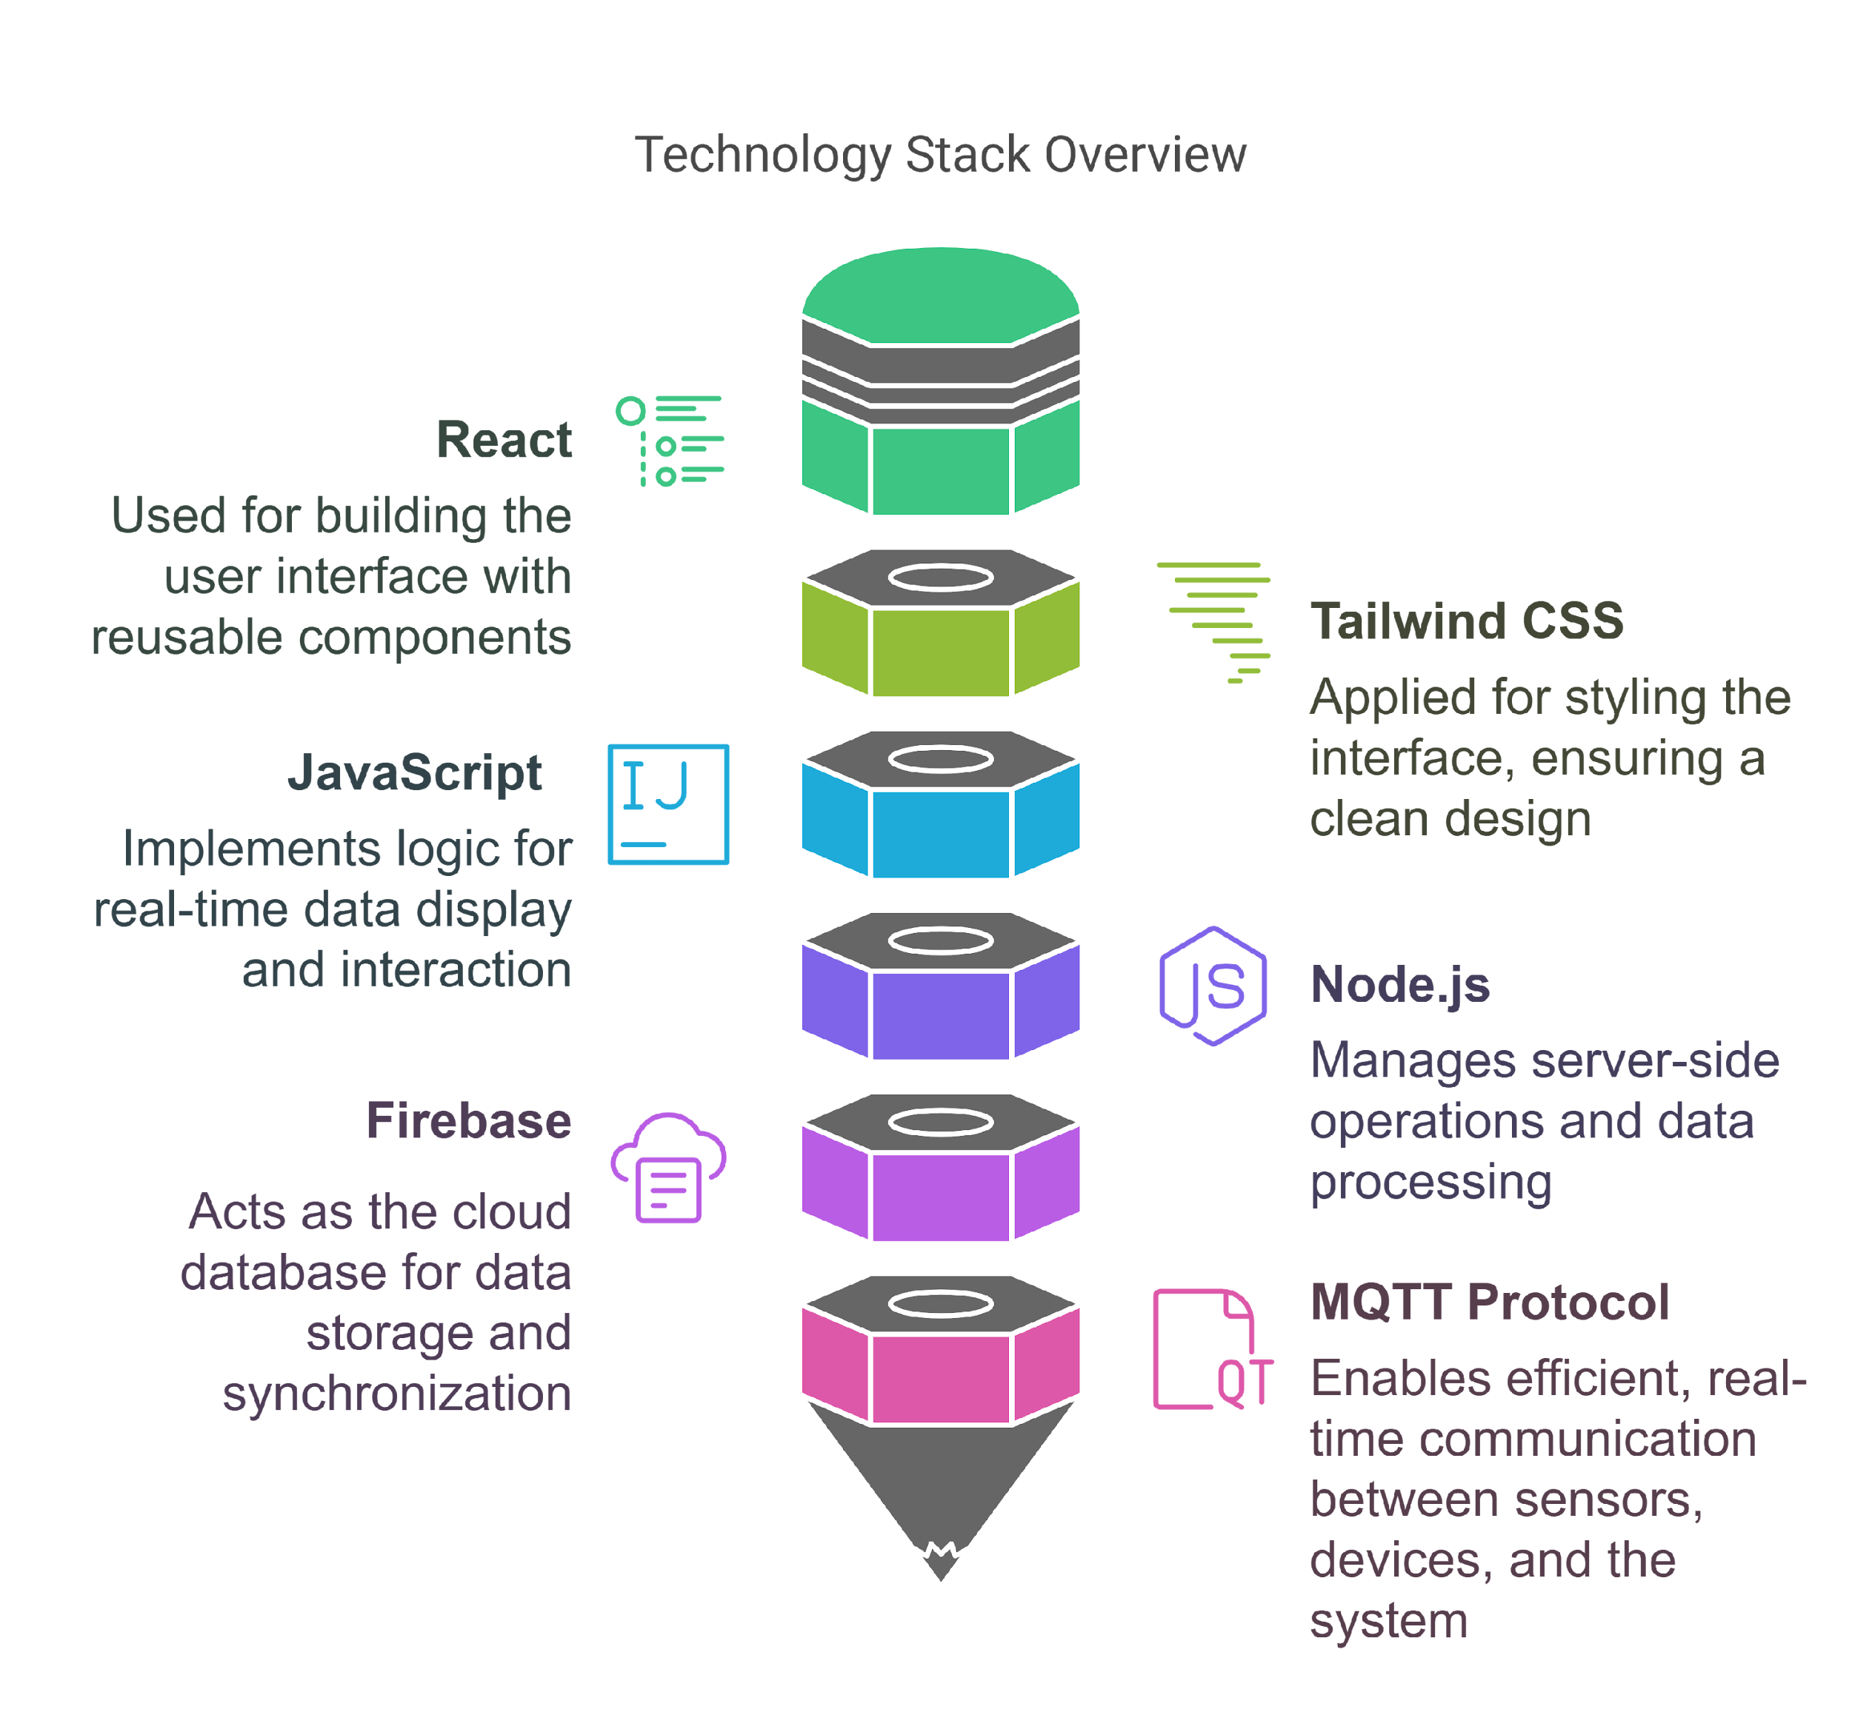
9
Technological Review
React
For building user interface with reusable components.
Tailwind CSS
Applied for styling the interface, ensuring a clean design.
JavaScript
Handles real-time data display and interaction logic.
Node.js
Manages server-side operations and data processing.
Firebase
Cloud database for data storage and synchronization.
MQTT Protocol
Enables real-time communication between sensors, devices, and system.

Slide 11
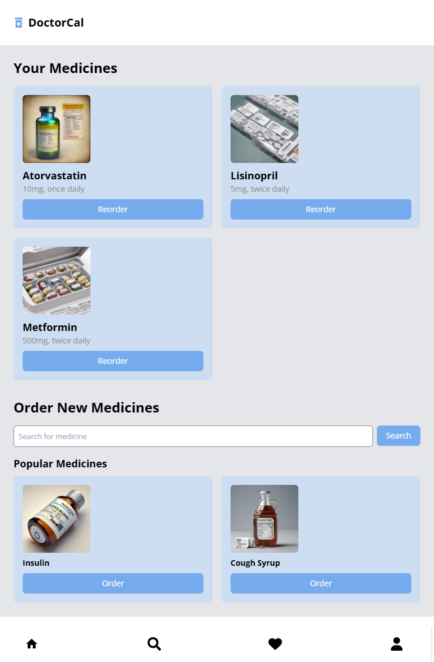
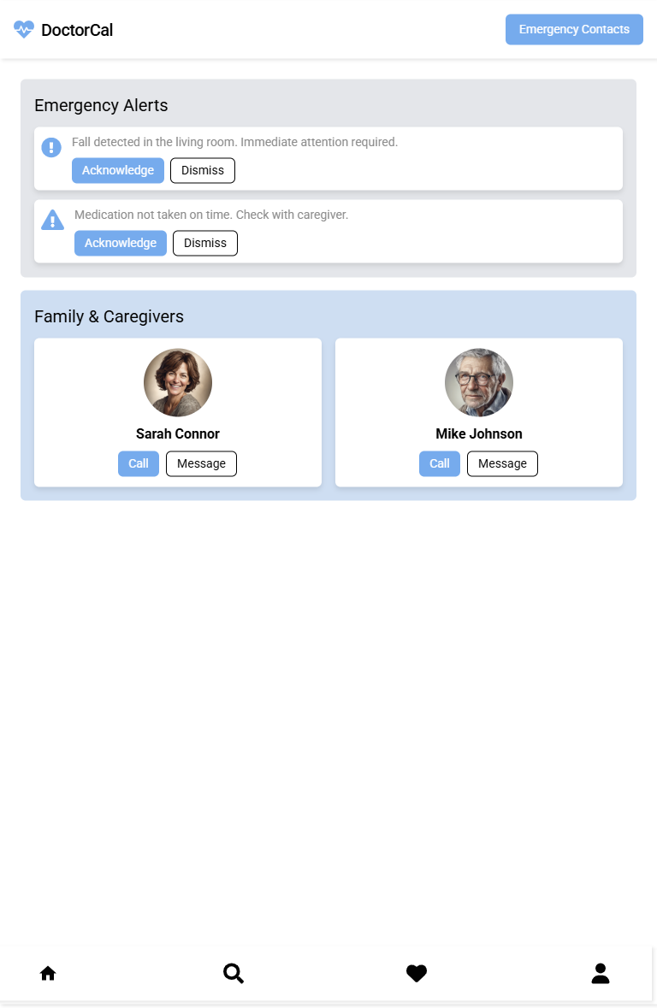
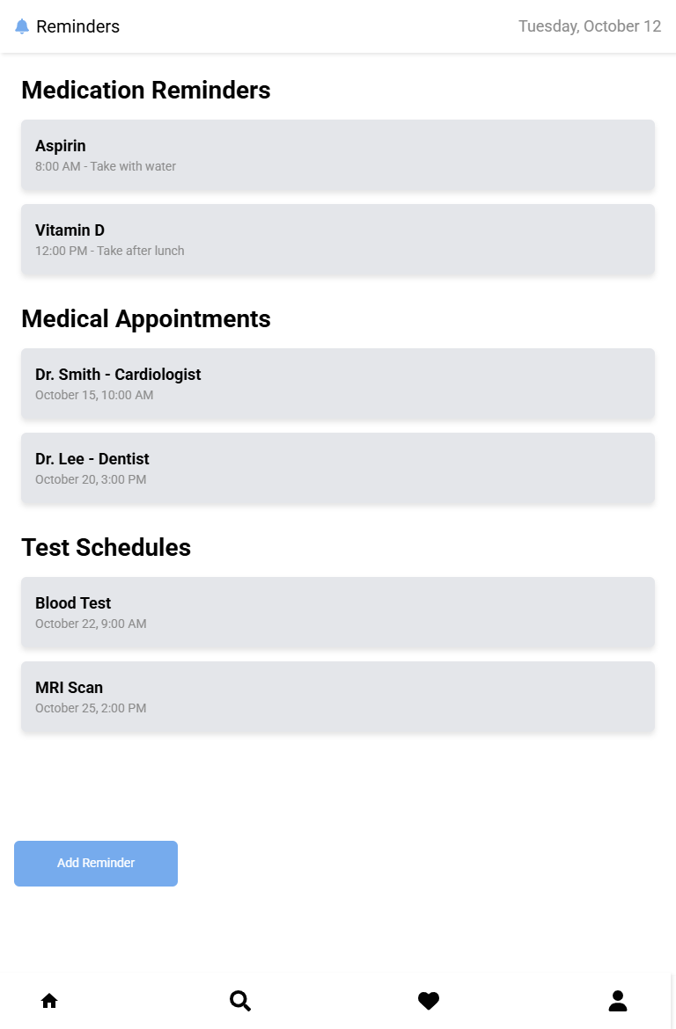
10
Mobile interface

Slide 12
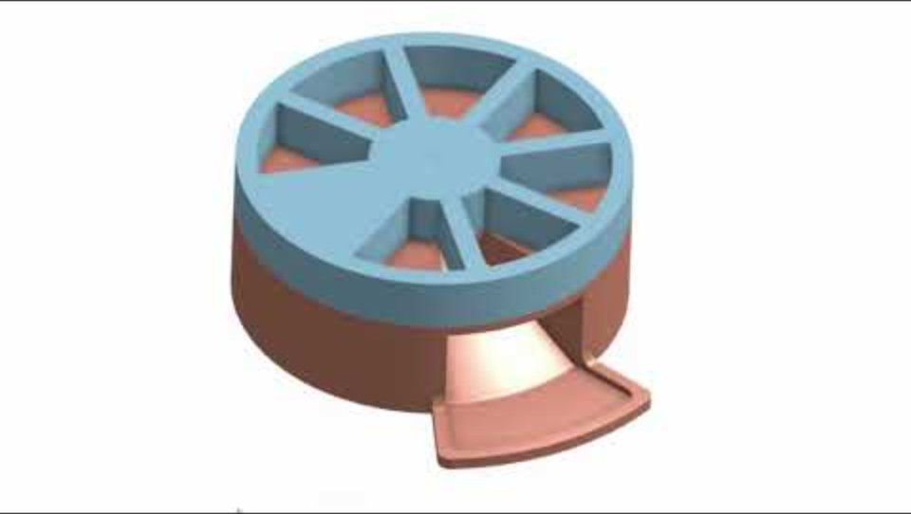
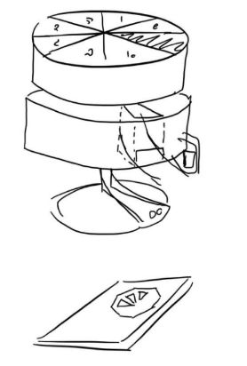
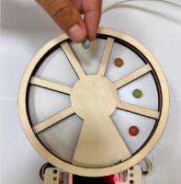
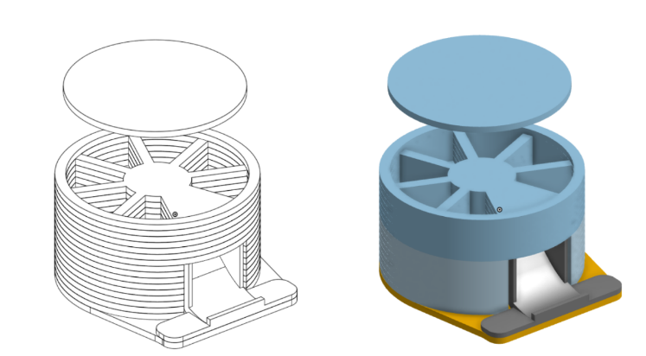
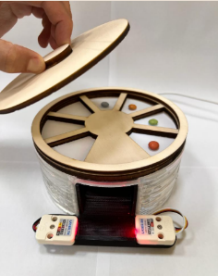
Mechanical Engineering
11
From this
Sketches
On-Shape
Module
PillMate – Smart Box

Slide 13
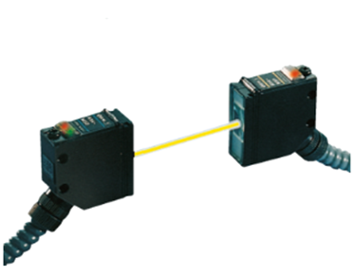
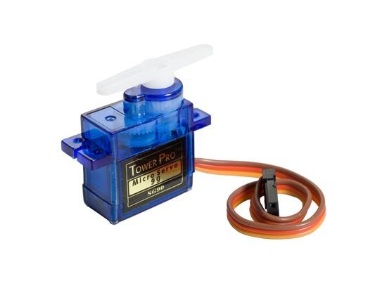
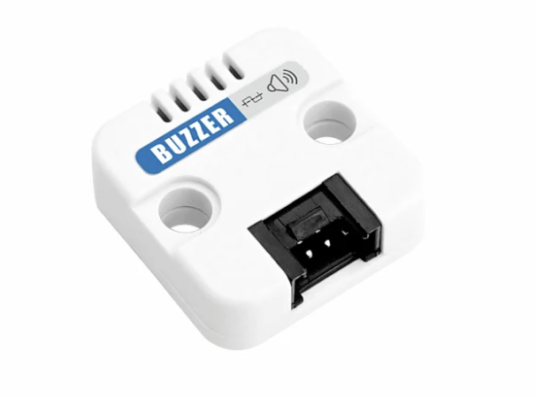
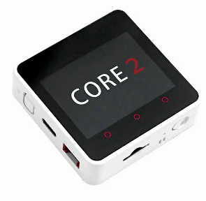
12
Mechanical Engineering
Number | Type of Hardware
1 | CORE2 controller
2 | Servo motor
3 | Laser sensor
4 | Buzzer
5 | Cables

Slide 14
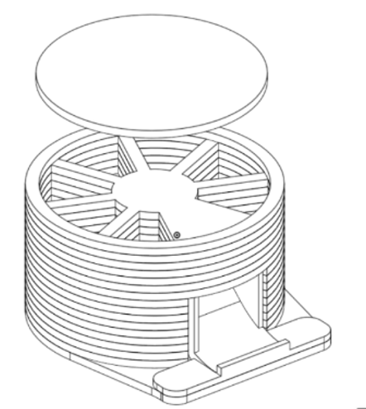



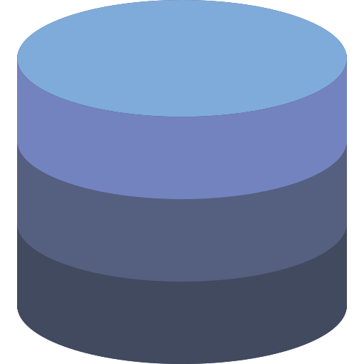




13
Application Layer Architecture
Server side
(Backend)
Cloud MQTT
Sensors
REST API
Frontend Stack
Backend Stack
React
NodeJS
Database

Slide 15
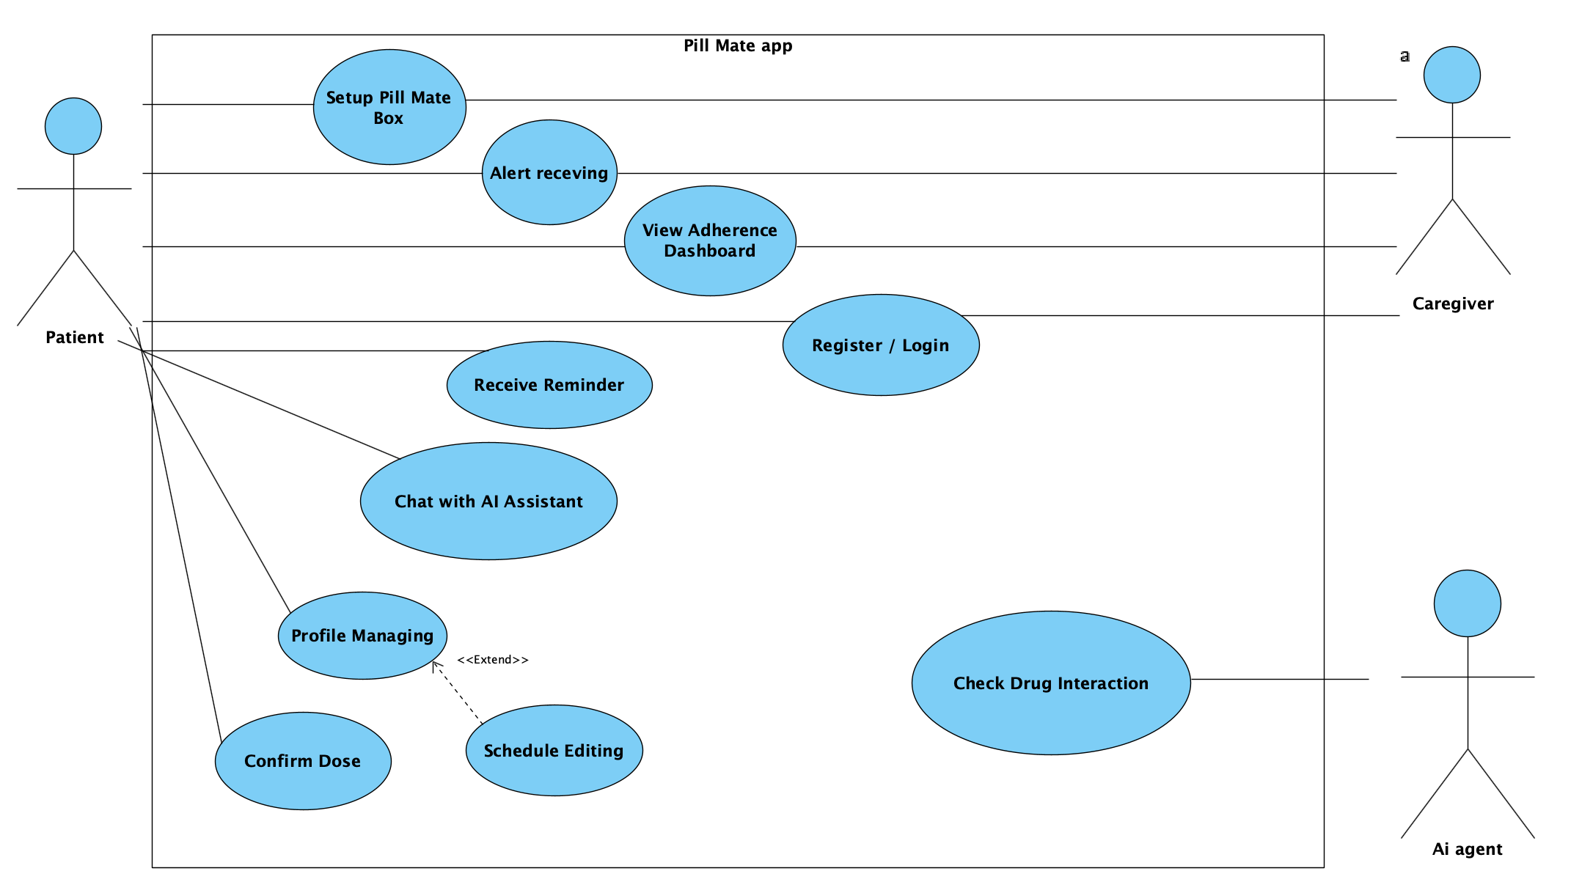
14
Use case Diagram

Slide 16
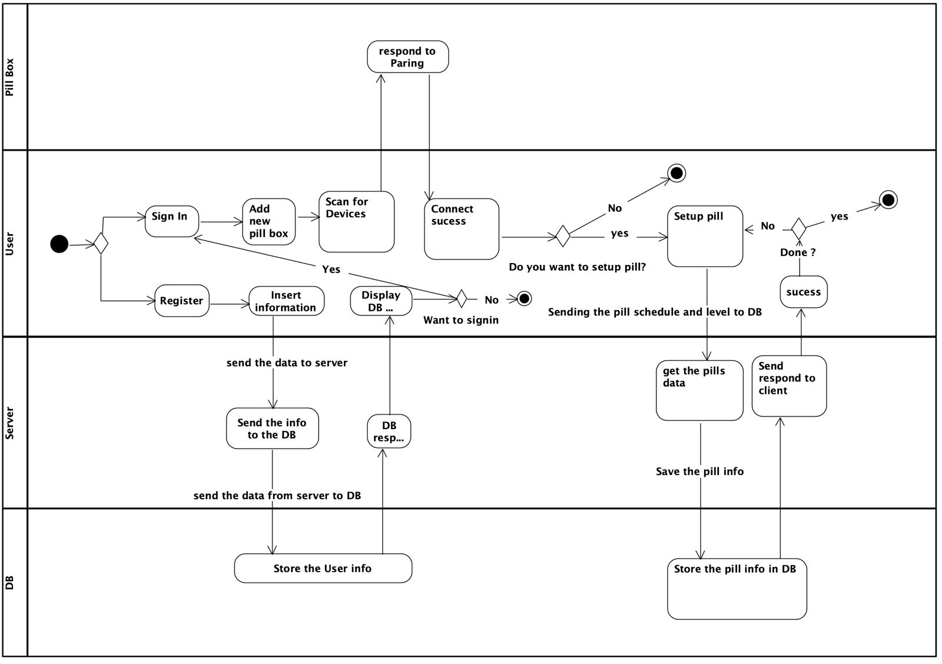
15
Activity Diagram

Slide 17
16
Activity Diagram

Slide 18
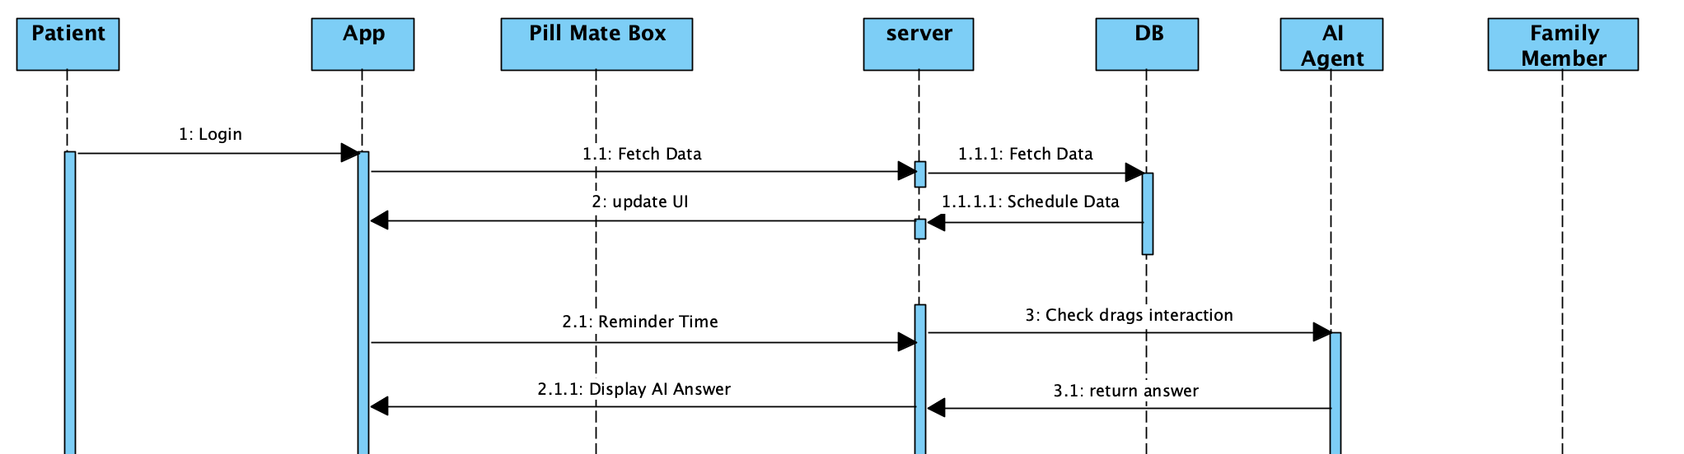
17
Sequence Diagram

Slide 19
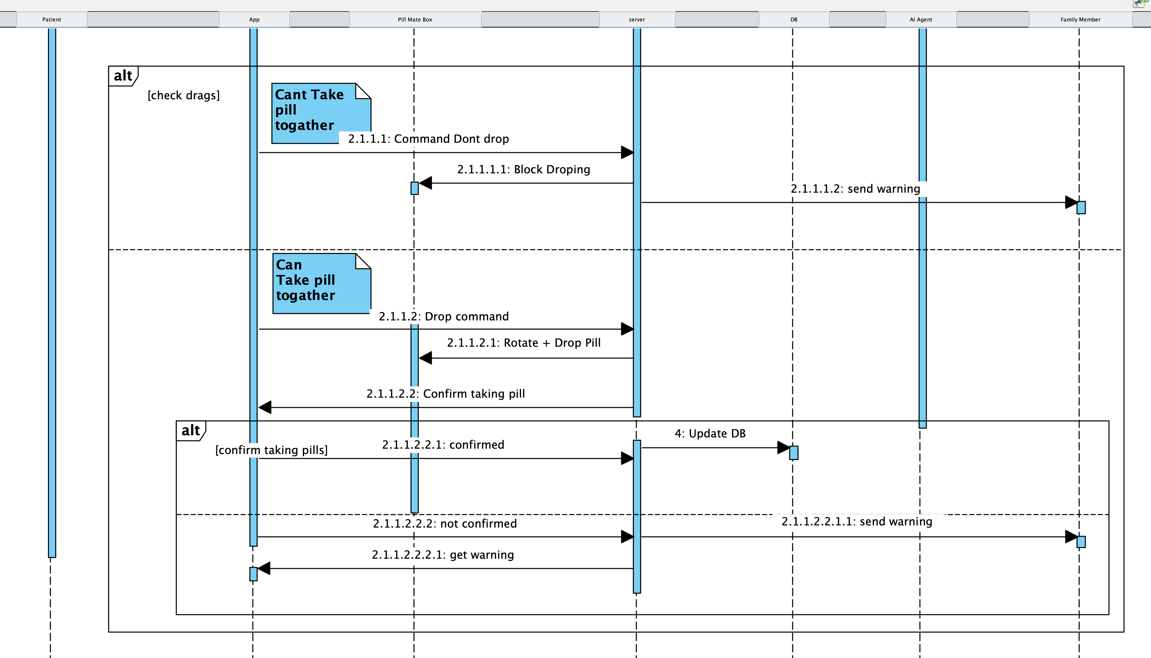
18
Sequence Diagram

Slide 20

19
Challenges We Could Face
🔧 Mechanical Side
Limited access to hardware components and tools
Difficulty testing the pill dispensing mechanism in real conditions
Integrating sensors into a compact physical design
💻 Software Side
Ensuring real-time sync between app, dispenser, and cloud
Developing a reliable AI model with limited data
Managing data privacy and secure access
Notes:
"We faced two main types of challenges. On the mechanical side, we didn’t always have access to all the sensors or tools needed, and it was hard to simulate real pill-taking. On the software side, syncing the data in real time, ensuring AI accuracy, and keeping user data private were the biggest hurdles."

Slide 21




20
Measuring Project Success
We built PillMate to solve a real problem.
Reduce or Double Doses
Verified Pill Removal in Real Time
Personalized Interaction Warnings
Positive User Feedback

Slide 22

Thank you for listening!
We are ready for your questions.
“Technology is best when it brings people together—and keeps them alive.” — Inspired by Matt Mullenweg

